Slide 1
Mental Health Assessment System for CRPF Personnel

Slide 2
Table of contents
01
06
02
07
03
08
04
09
Problem Statement
Results
Objectives
Future Scope
Technology Stack
Conclusions
Features
References
05
Methodology

Slide 3
Problem statement
CRPF personnel work in high-stress environments where demanding and risky situations take a heavy toll on their mental health. Despite the critical need for mental well-being, there’s no real-time system in place to monitor stress levels or provide early intervention. This lack of timely support often affects decision-making, physical health, and overall efficiency, leading to delayed responses and worsening conditions. An automated solution is essential to track mental health, send timely alerts, and ensure effective follow-up for long-term well-being.

Slide 4
Objectives
Automated Stress Detection: Uses a structured survey to assess and quantify mental health through regular, rating-based questions.
Timely Intervention: Automatically alerts department heads when high-stress levels are detected, ensuring quick action and support.
Real-Time Mental Health Tracking: Tracks stress patterns over time, enabling proactive monitoring and early intervention.
Secure Login & Assessment: Ensures only authorized personnel access the system via Firebase Authentication, protecting sensitive data.
Admin Dashboard: Provides a centralized view of stress levels, highlighting high-stress cases and generating weekly and monthly reports.

Slide 5
Technology Stack
Frontend: React.js:
React.js is used to build a responsive and interactive user interface for both CRPF personnel and admins. It offers component-based architecture, making it easy to manage different parts of the application like the survey form, admin dashboard, and login system.
Authentication: Firebase Authentication: Firebase Authentication provides secure and reliable login functionality using email and password-based authentication. It ensures that only authorized CRPF personnel and admins can access the system, protecting sensitive mental health data from unauthorized access.

Slide 6
Technology Stack
Database & Storage: Firebase Firestore (NoSQL Database):
Firebase Firestore is a cloud-hosted, NoSQL database that stores survey responses, user profiles, and stress level reports in real-time.
Alert System: Firestore Triggers & Email Notifications: Firestore triggers monitor the survey responses in real-time and automatically detect high-stress cases based on predefined thresholds.
SMS Alert: Twilio
Twilio is a cloud communication platform that allows developers to send SMS alerts and messages through its API.

Slide 7
Features and Functionalities
Secure Login: Uses Firebase Authentication to ensure only authorized CRPF personnel and admins can access the system, protecting sensitive mental health data.
Timed Assessment: Conducts time-bound surveys (within 3 minutes) to prevent random or fake responses and maintain data accuracy.
Stress Score Calculation: Evaluates survey responses in real-time, generating stress scores based on weighted criteria for quick analysis.
Automatic Alerts: Triggers instant notifications to department heads when high-stress levels are detected, enabling fast and effective intervention.
Admin Dashboard: Provides a centralized, real-time view of personnel’s stress levels, highlighting critical cases and generating weekly and monthly reports.

Slide 8
Stress Score Calculation
Stress Score Formula:
Adding up all the answers from the survey.
Finding the maximum possible score.
Per question weightage ‘5’ which makes Max Score as ’75’.
Calculating a stress percentage using the formula:
Stress Percentage = (1 – (Total Score / Max Score)) * 100
Deciding if stress is "High" or “Low" based on whether the percentage is above 61%.

Slide 9
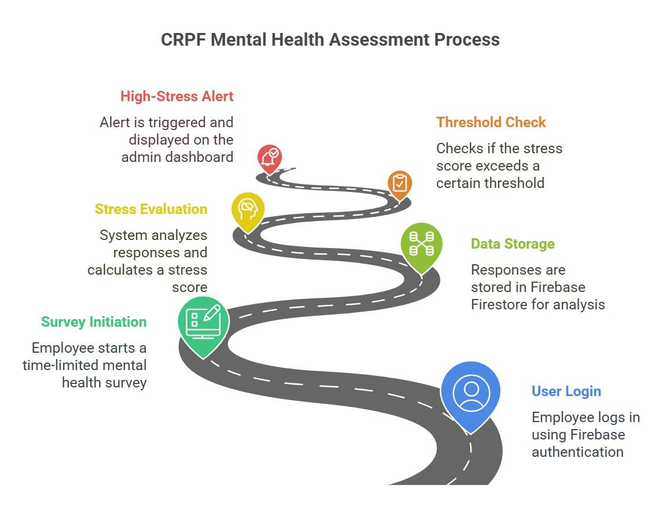
Methodology

Slide 10
Results and Current Status
Survey System: Fully functional and stores real-time responses in Firebase Firestore.
Stress Evaluation: Automated stress calculation with instant scoring based on survey responses.
Alert System: Real-time alerts notify department heads immediately when high-stress levels are detected.
Admin Dashboard: Tracks and highlights high-stress cases, enabling quick intervention.
System Readiness: Stable, optimized, and ready for further testing and deployment.
Report Generation: Weekly and monthly reports help track long-term mental health trends.

Slide 11
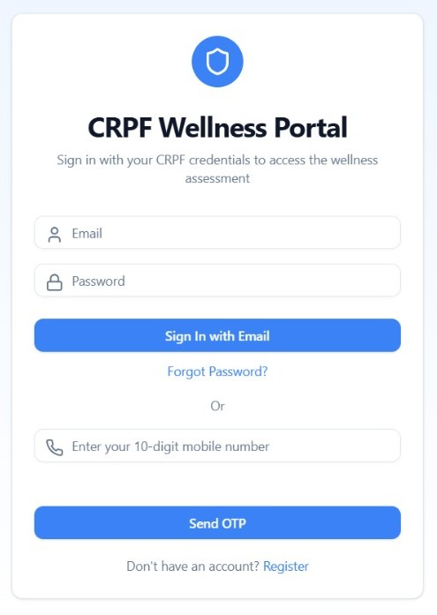
Introductory/Login Page:

Slide 12
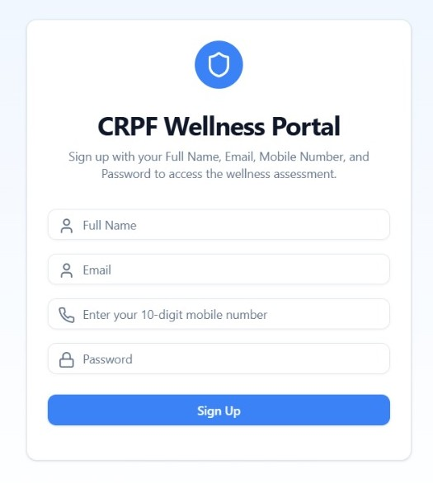
Signup page:

Slide 13
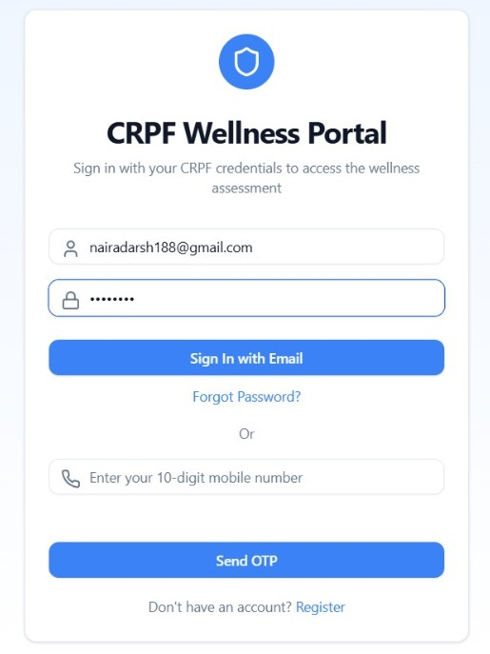
Admin Login:

Slide 14
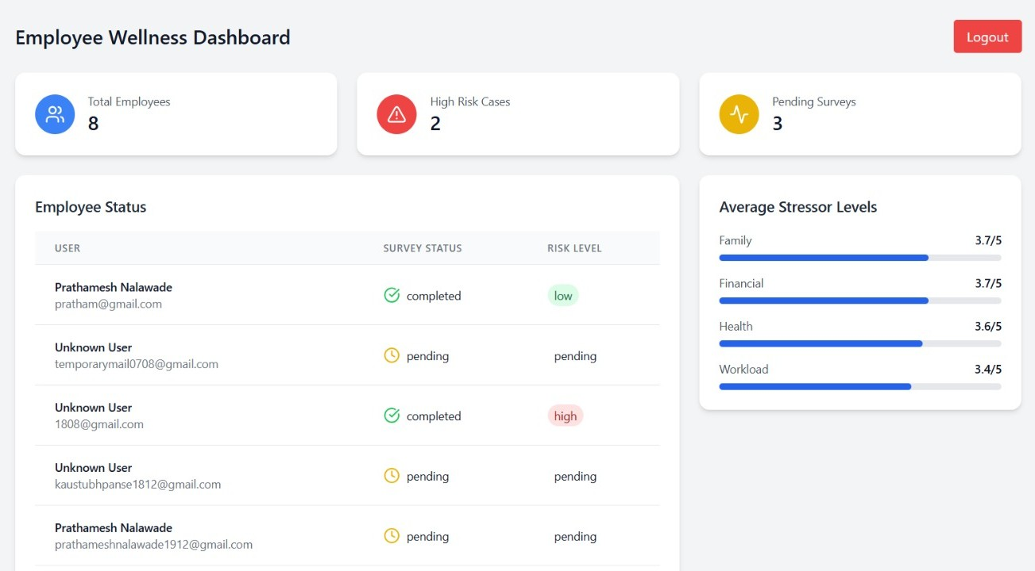
Admin Dashboard:

Slide 15
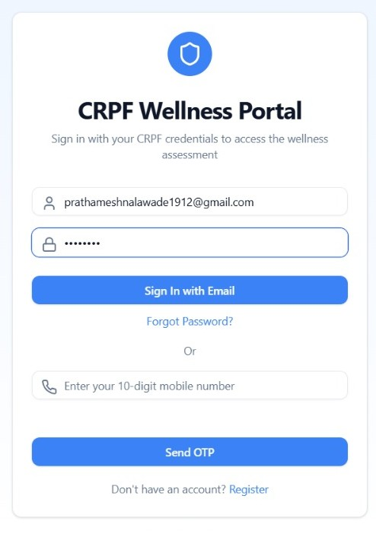
User Login:

Slide 16
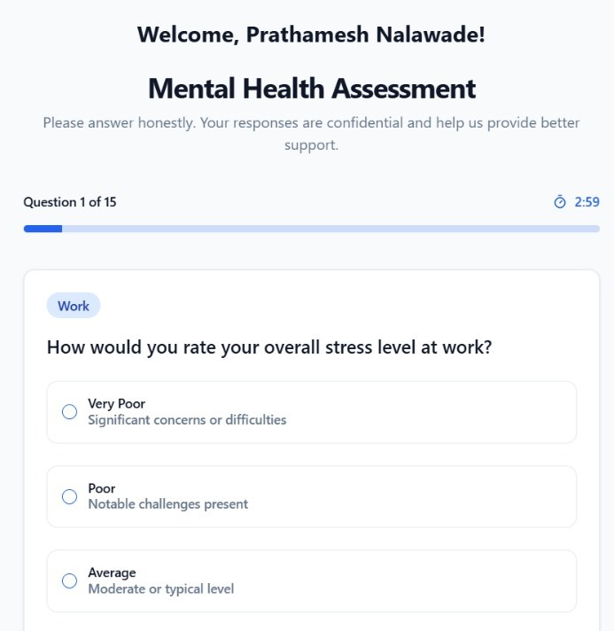
User login followed by a personalized welcome and questionnaire:

Slide 17
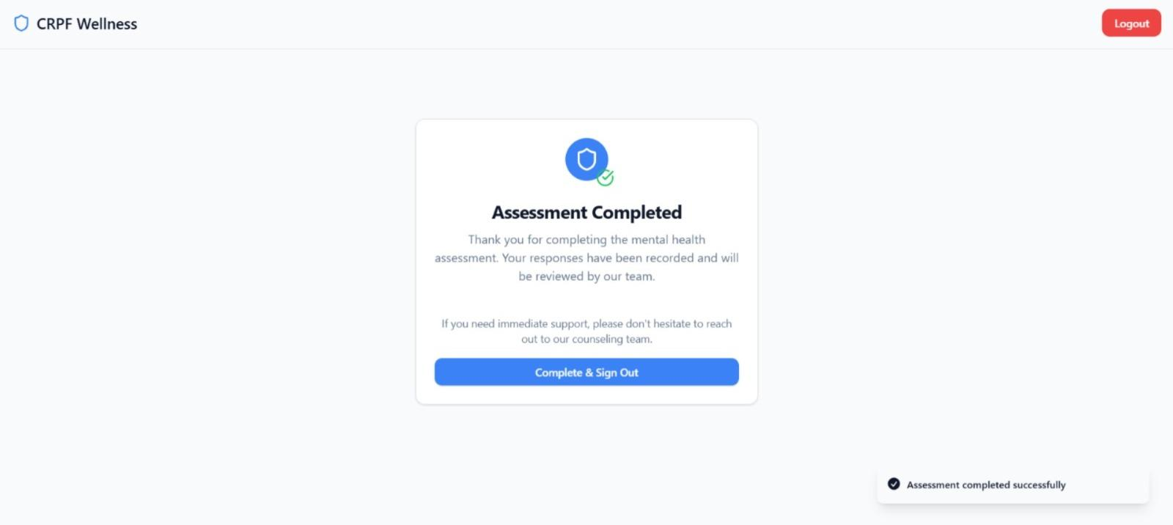
Confirmation screen indicating the completion of the assessment:

Slide 18
Future Scope
ML Model Integration: Implementing a machine learning model to enhance stress analysis accuracy by identifying patterns and trends in survey responses.
Personalized Therapy Module: Introducing a customized support system offering personalized therapy recommendations based on individual stress patterns.
Data Analytics Dashboard: Building a visual analytics dashboard to track mental health trends over time, enabling informed decision-making and proactive interventions.
Integration with Health Records: Linking the system with existing medical records to monitor long-term health improvements and provide holistic care.

Slide 19
Conclusions
Importance of the Project: This system enhances the mental well-being of CRPF personnel by providing consistent mental health monitoring.
Problem Solved: It addresses the lack of real-time stress assessment, enabling early detection of high-stress levels and immediate intervention, which improves decision-making and overall efficiency.
Next Steps: Moving forward with field testing to validate system performance, followed by optimization based on feedback and implementing advanced features like ML integration and therapy module.

Slide 20
References
IEEE References
1. S. Cohen, T. Kamarck, and R. Mermelstein, “A global measure of perceived stress,” J. Health Soc. Behav., vol. 24, no. 4, pp. 385–396, 1983. doi: 10.2307/2136404.
2. P. F. Lovibond and S. H. Lovibond, “The structure of negative emotional states: Comparison of the Depression Anxiety Stress Scales (DASS) with the Beck Depression and Anxiety Inventories,” Behav. Res. Ther., vol. 33, no. 3, pp. 335–343, 1995. doi: 10.1016/0005-7967(94)00075-U.
3. S. Levenstein et al., “Development of the Perceived Stress Questionnaire: A new tool for psychosomatic research,” J. Psychosom. Res., vol. 37, no. 1, pp. 19–32, 1993. doi: 10.1016/0022-3999(93)90120-5.

Slide 21
Thank You!

